Slide 1
Object-oriented Programming
Week 6

Slide 2
Storage Classes
To fully define a variable one needs to mention not only its ‘type’ but also its ‘storage class’.
In other words, not only do all variables have a data type, they also have a ‘storage class’.
storage classes have defaults, If we don’t specify the storage class of a variable in its declaration,
There are basically two kinds of locations in a computer where such a value may be kept—
Memory and CPU registers.
It is the variable’s storage class that determines in which of these two locations the value is stored.

Slide 3
Storage Classes
Moreover, a variable’s storage class tells us:
(a) Where the variable would be stored.
(b) What will be the initial value of the variable, if initial value is not specifically assigned.(i.e. the default initial value).
(c) What is the scope of the variable; i.e. in which functions the value of the variable would be available.
(d) What is the life of the variable; i.e. how long would the variable exist.

Slide 4
Storage-class Specifiers
Auto
Register
Extern
Static
Mutable

Slide 5
static storage class
Storage − Memory.
Default initial value − Zero.
Scope − Local to the block in which the variable is defined.
Life − Value of the variable persists between different function calls.

Slide 6













Slide 7














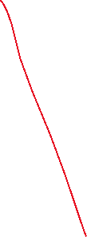



A simple function call
void staticDemo()
{
int val = 0;
++val;
cout << “val = " << val << endl;
}
int main()
{
staticDemo(); // prints val = 1
staticDemo(); // prints val = 1
staticDemo(); // prints val = 1
}

Slide 8




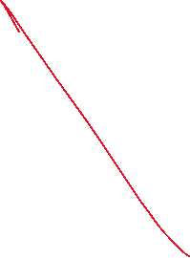









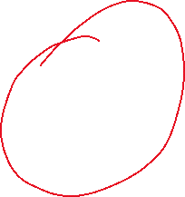

Static Local Variables
void staticDemo()
{
static int val = 0;
++val;
cout << “val = " << val << endl;
}
int main()
{
staticDemo(); // prints val = 1
staticDemo(); // prints val = 2
staticDemo(); // prints val = 3
}

Slide 9
static void counter() {
static int count = 0; // Stored in Data Segment, persists
++count;
cout << "Count: " << count << endl;
}

Slide 10
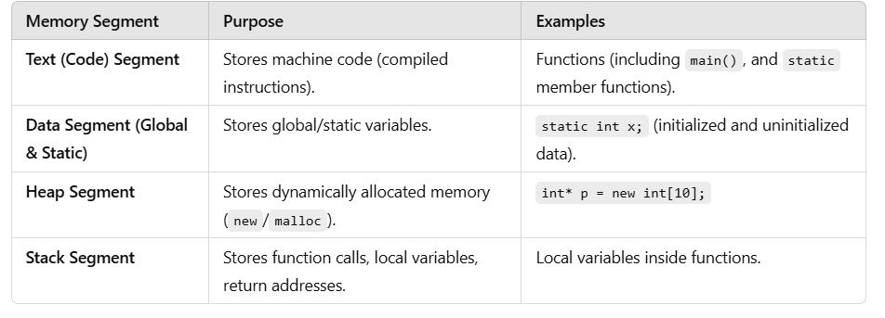
Memory Layout

Slide 11
Static main
main() is not static because:
It must be accessible globally as the program’s entry point.
The C++ standard requires it to have external linkage.
It is not a member of a class, so static has no meaning here.

Slide 12
Static Data Member
A data member of a class can be qualified as static
It exists even if no objects are created, but it is initialized only once.
Only one copy of that member is created for the entire class and is shared by all the objects of that class, no matter how many objects are created.
It is visible only within the class, but its lifetime is the entire program

Slide 13
Static Data Member
A static variable is normally used to maintain value common to the entire class. For e.g, to hold the count of objects created. Note that the type and scope of each static member variable must be declared outside the class definition. This is necessary because the static data members are stored separately rather than as a part of an object.

Slide 14
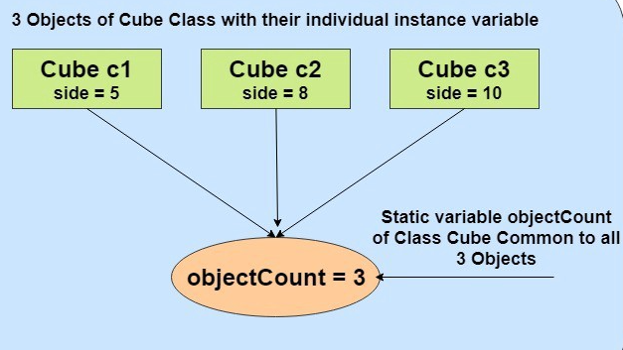

Slide 15





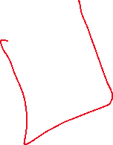












Slide 16

Declaration
Defining the static data member It should be defined outside of the class following this syntax:
data_type class_name :: member_name =value;

Slide 17
#include <iostream>
using namespace std;
class Demo{
public:
static int ABC;};
//defining
int Demo :: ABC ;
int main()
{
cout<<"\nValue of ABC: "<<Demo::ABC;
return 0;
}

Slide 18
#include <iostream>
using namespace std;
class Demo{
public:
static int ABC;};
//defining
int Demo :: ABC =10;
int main()
{
cout<<"\nValue of ABC: "<<Demo::ABC;
return 0;
}

Slide 19
Static Member Function
A static function can have access to only other static
members (function or variable) declared in the same class.
A static member function can be called using the
class name (instead of its object) as follows-
Class_name::Function_name();

Slide 20
#include <iostream> using namespace std;
class Demo{ private: static int X;
public: static void fun(){ cout <<"Value of X: " << X << endl; } };//defining int Demo :: X =10; int main(){ Demo X; X.fun(); return 0; }

Slide 21
#include <iostream> using namespace std;
class Demo{ private:
int a; static int X;
public: static void fun(){ cout <<"Value of X: " << X << endl;
cout <<"Value of a: " << a << endl; //[Error] invalid use of member 'Demo::a' in static member function } };//defining int Demo :: X =10; int main(){ Demo X; X.fun(); return 0; }

Slide 22
Non static member func
#include <iostream> using namespace std;
class Demo{ private:
int a; static int X;
public: void fun(){ cout <<"Value of X: " << X << endl;
cout <<"Value of a: " << a << endl;} };//defining int Demo :: X =10; int main(){ Demo X; X.fun(); return 0; }

Slide 23
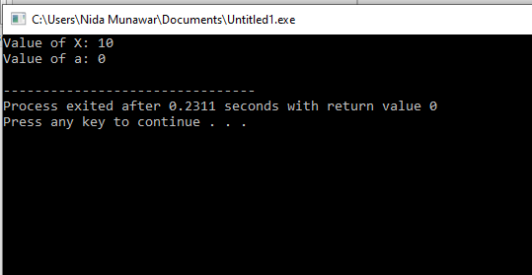

Slide 24
Difference between a static variable and global variable
All global variables are static, but all static variables are not necessarily global.
static variables have visibility limited to the function in which declared.
What all static variables (including global) have in common is that they have a lifetime that lasts the duration of the program. They are initialized just once, when the program begins.

Slide 25
Non static object
#include <iostream>
using namespace std;
class Counter {
public:
Counter() {
cout << "Constructor Called" << endl;
count = 0; }
~Counter() {
cout << "Destructor Called" << endl;
}
void increment() {
count++;
cout << "Count: " << count << endl;
}
private:
int count;
};
void testFunction() {
Counter obj;
obj.increment();

Slide 26
}
int main() {
cout << "Inside Main" << endl;
testFunction(); // First call
testFunction(); // Second call
testFunction(); // Third call
cout << "Exiting Main" << endl;
return 0;
}

Slide 27
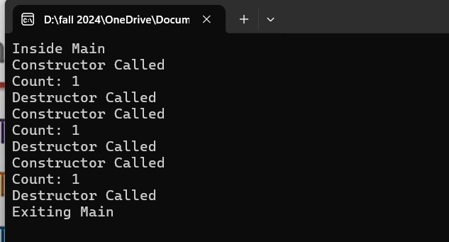

Slide 28
Static object
#include <iostream>
using namespace std;
class Counter {
public:
Counter() {
cout << "Constructor Called" << endl;
count = 0; }
~Counter() {
cout << "Destructor Called" << endl;
}
void increment() {
count++;
cout << "Count: " << count << endl;
}
private:
int count;
};
void testFunction() {
static Counter obj; // Static object inside function
obj.increment(); // Retains value across function calls
}

Slide 29
int main() {
cout << "Inside Main" << endl;
testFunction(); // First call
testFunction(); // Second call
testFunction(); // Third call
cout << "Exiting Main" << endl;
return 0;
}

Slide 30
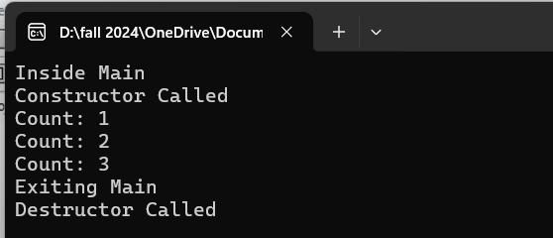

Slide 31
Why Can't Constructors Be Static?
A constructor is responsible for initializing an instance of a class.
Static functions belong to the class, not to any instance.
A constructor must always be tied to an object being created,
which contradicts the purpose of a static function.
If a constructor were static, it wouldn’t be able to initialize non-static members.

Slide 32
Automatic Storage Class
The auto storage class is the default storage class for all local variables.
Storage − Memory.
Default initial value − An unpredictable value, which is often called a garbage value.
Scope − Local to the block in which the variable is defined.
Life − Till the control remains within the block in which the variable is defined.

Slide 33
Automatic Storage Class
{
Int count;
OR
auto int count;
}

Slide 34
Register Storage Class
The features of a variable defined to be of register storage class are as under:
Storage - CPU registers.
Default initial value - Garbage value.
Scope - Local to the block in which the variable is defined.
Life - Till the control remains within the block in which the variable is defined.

Slide 35
A value stored in a CPU register can always be accessed faster than the one that is stored in memory.
{
Register int count;
}

Slide 36
External Storage Class
The extern storage class is used to give a reference of a global variable that is visible to ALL the program files. When you use 'extern' the variable cannot be initialized as all it does is point the variable name at a storage location that has been previously defined.
When you have multiple files and you define a global variable or function, which will be used in other files also, then extern will be used in another file to give reference of defined variable or function. Just for understanding extern is used to declare a global variable or function in another file.

Slide 37
main.cpp
#include <iostream>
int count ;
extern void write_extern();
main() {
count = 5;
write_extern();
}

Slide 38
support.cpp
#include <iostream>
extern int count;
void write_extern(void) {
std::cout << "Count is " << count << std::endl;}
Here, extern keyword is being used to declare count in another file.

Slide 39
mutable Storage Class
It allows a member of an object to override const member function. That is, a mutable member can be modified by a const member function.

Slide 40
A simple program
class A
{
int val;
public:
A(int x)
{
val = x;
}
void changeVal(int x) const
{
val = x; //Error: cannot change val
}
};
int main()
{
const A a(10);
a.changeVal(20);
}

Slide 41
Mutable Variables
class A
{
mutable int val;
public:
A(int x)
{
val = x;
}
void changeVal(int x) const
{
val = x;
}
};
int main()
{
const A a(10);
a.changeVal(20);
}

Slide 42
Same with static
class A
{
static int val;
public:
A(int x)
{
val = x;
}
void changeVal(int x) const
{
val++;
}
};
int A :: val=0;
int main()
{
const A a(10);
a.changeVal(20);
}

